Slide 1

IPL Match Predictor
Done By:
Varun Bhattacharya
Notes:
Good morning everyone present here, I am Varun Bhattacharya, Reg no 20BIT0436 and my topic is IPL Match Predictor.

Slide 2

Idea
Notes:
The main idea behind the project is to give the user the predicted winner team before hand based on previous statistics so that they can put money on the correct team and hence can win from various different online sources like Dream11, Howzat, My11Circle, etc.

Slide 3
Project Idea
The main objective of this project is to provide the users a probable and almost accurate winner for any upcoming Indian Premier League (IPL) cricket match by using different machine learning algorithms of the user’s choice.
Notes:
As discussed earlier, the main objective of this project is to provide the users a probable and almost accurate winner for any upcoming Indian Premier League (IPL) cricket match by using different machine learning algorithms of their choice.

Slide 4

Software Requirements
Notes:
The following are the tech stack used to build this project.

Slide 5
Project Software Requirements
The following tech stack has been used to build the project:-
Python (3.10) for machine learning algorithms and manipulations
XAMPP Server for start of server
PHP for Db connections and manipulations
PhpMyAdmin for Db checks
MySQL for the Db storage
HTML for the frontend GUI build
CSS for the frontend GUI build
JavaScript for the manipulations in backend
Figma for UI design
Adobe Photoshop for custom made pictures
Adobe Premier Pro for custom video build
Notes:
--Read through it--

Slide 6
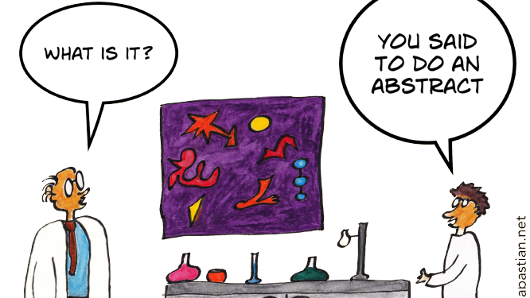
Abstract
Notes:
i.) Cricket is one of the most liked, played, and encouraged sport in today’s time.
ii.) With the increasing number of matches with time, the data related to cricket matches and the individual player are increasing rapidly.
iii.) There aroused many different types of apps, where we select the probable winning team and get rewarded at the end.
iv.) Putting all the previous data to use, by predicting the winning team based on previous statistics using machine learning models became the main motive to get the probable accurate answer for their inputs.

Slide 7
Project Abstract
Cricket is one of the most liked, played, encouraged, and exciting sports in today’s time that requires a proper advancement with machine learning and artificial intelligence (AI) to attain more accuracy.
With the increasing number of matches with time, the data related to cricket matches and the individual player are increasing rapidly. The Indian Premier League (IPL) is a professional Twenty20 cricket league that is governed by the Board of Control for Cricket in India (BCCI).
The Indian Premier League is conducted every year and participating teams represent a city in India. As the technology is growing, and many betting sites are getting popular these days.
Notes:
--Read through it--

Slide 8
Project Abstract
As a result, people tend to rely indirectly on predictions such as the winner of the team, expected score. Hence, to make such predictions, we use various different machine learning algorithms to predict the outcome of a particular match and try to have the most efficient outcome of winning the matches on their previous history.
In the following website, the prediction of the winner of the match will be done based on some inputs from the user such as the team 1, team 2, the city played and toss winner.
Also, the user also has to choose the machine learning algorithm via which they want their prediction to be made.
Once, the prediction made, the user can be sure of the outcome by checking it out using different machine learning algorithms given in the options and can get the results before the match is played.
Notes:
--Read through it--

Slide 9
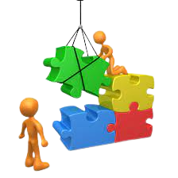
Build
Notes:
Here comes the main architecture of the project.
i.) The following website uses five different webpages for getting the required information from the user and also gives the required details to the user.
ii.) At first, if it is a new user, they have to sign up to get logged in to the system, else if it is a returning user, he/she can directly enter the website just by using their log-in credentials.
iii.) Next, the user will be directed towards the dashboard where they can see the details on how to use the web application.
iv.) The user will then be redirected to the selection page where they can select the teams and the algorithm they want to use for predicting the winning team.
v.) Finally, we get the result based on the input stats given by the user.

Slide 10
Project Build
The website build for this purpose utilizes five different webpages.
At first, the user have to log in to the website with their required credentials and if the user is not a past user and doesn’t have an account in the database system, the user first has to sign up to the web application and there they have to fill the required information for using the predictor machine.
Once, the user has made an account in the application, they will be redirected to the log in page again where they can log in with their username and password.
Once they do so, they will be redirected to the dashboard of the application where they can read the guidelines and can start predicting for upcoming cricket matches.
Notes:
--Read through it--

Slide 11
Project Build
From here they will be prompted for giving some basic information for prediction such as the teams against which they will/are playing, the city in which the match is to be played/playing, toss winner and majorly the machine learning algorithm via which they want their prediction.
Given this information, when the user clicks on the submit button, they will be taken to the output page where the prediction result will be shown and will be given an option of returning back to the dashboard again for further predictions.
Below is a outline of how the webpages flow will look like. Also, the database design has also being portrayed below in the form of ER Diagram.
Notes:
--Read through it--

Slide 12
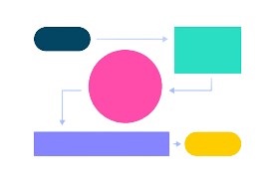
Webpage Flow
Notes:
The outline of the different webpage flow has been depicted in the next slide.

Slide 13
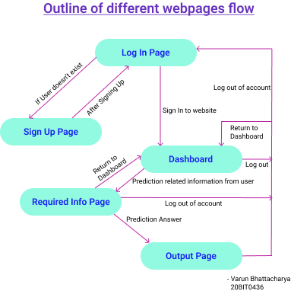
Outline of different webpages flow
Notes:
--Explain if required--

Slide 14
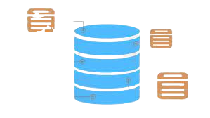
ER Diagram
Notes:
The ER Diagram has been depicted in the next slide.

Slide 15
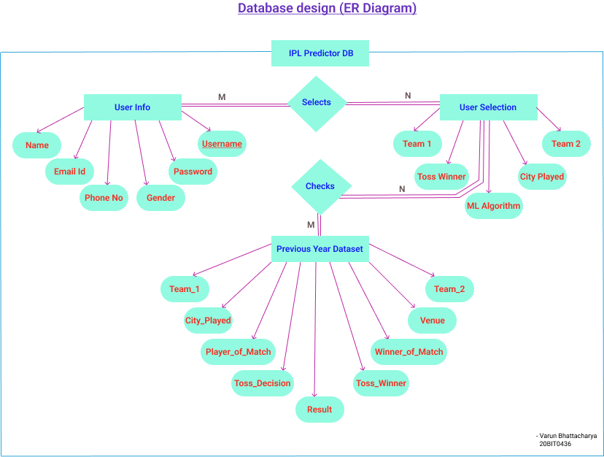
Database Design (ER Diagram)
Notes:
--Explain if required--

Slide 16

Expectation !!!
Notes:
The outcome of this project is to predict the winning team based on the user selections and from previous history of data.

Slide 17
Expected Result
Given all this case, the user can successful login and sign up by getting their details registered in the database and can predict the match winner accordingly by the options selected by the user from various different options available in the menu selection.
Notes:
--Read through it--

Slide 18

Innovation
Notes:
The following predictor machine uses various different machine learning algorithms to predict the result with an accuracy rate of 99.34%.

Slide 19
Innovative idea used
The following predictor machine gives user the choice to predict with different machine learning algorithms and get the results with 99.34% accuracy rate. The user gives the required information which gets stored in the database using Php and MySQL manipulations which is used in further processes in prediction.
Notes:
--Read through it--

Slide 20

Screenshots of the UI Design
Notes:
The following are the screenshots of the UI taken.

Slide 21
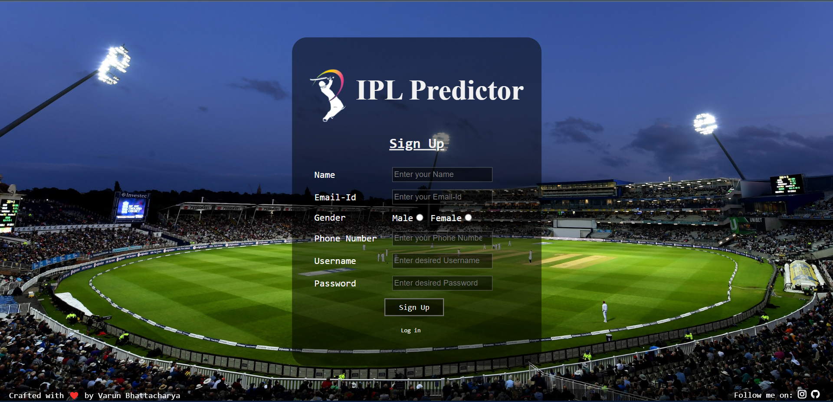
Sign-Up Page
Notes:
--Show and next--

Slide 22
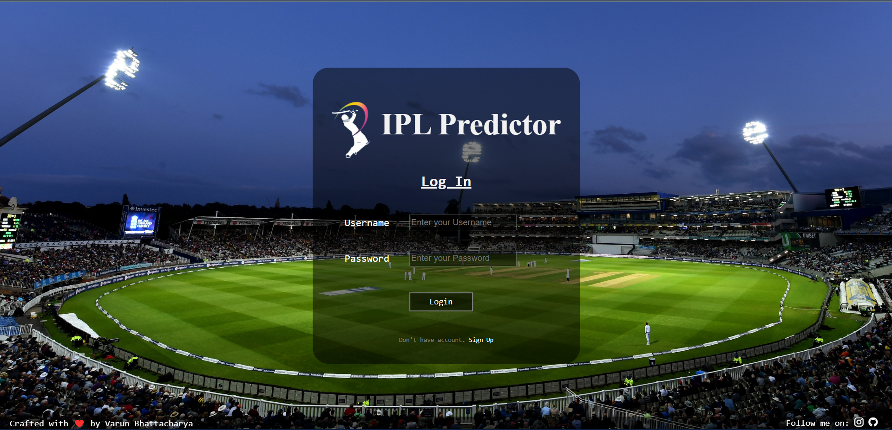
Log-In Page
Notes:
--Show and next--

Slide 23
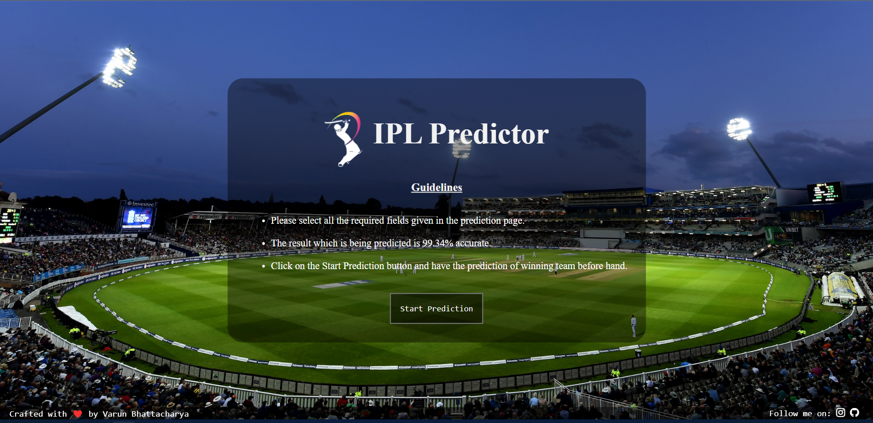
Dashboard
Notes:
--Show and next--

Slide 24
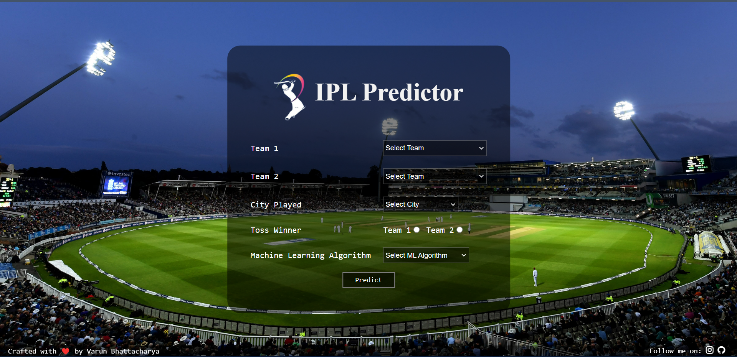
Selection of Teams and Algorithm
Notes:
--Show and next--

Slide 25
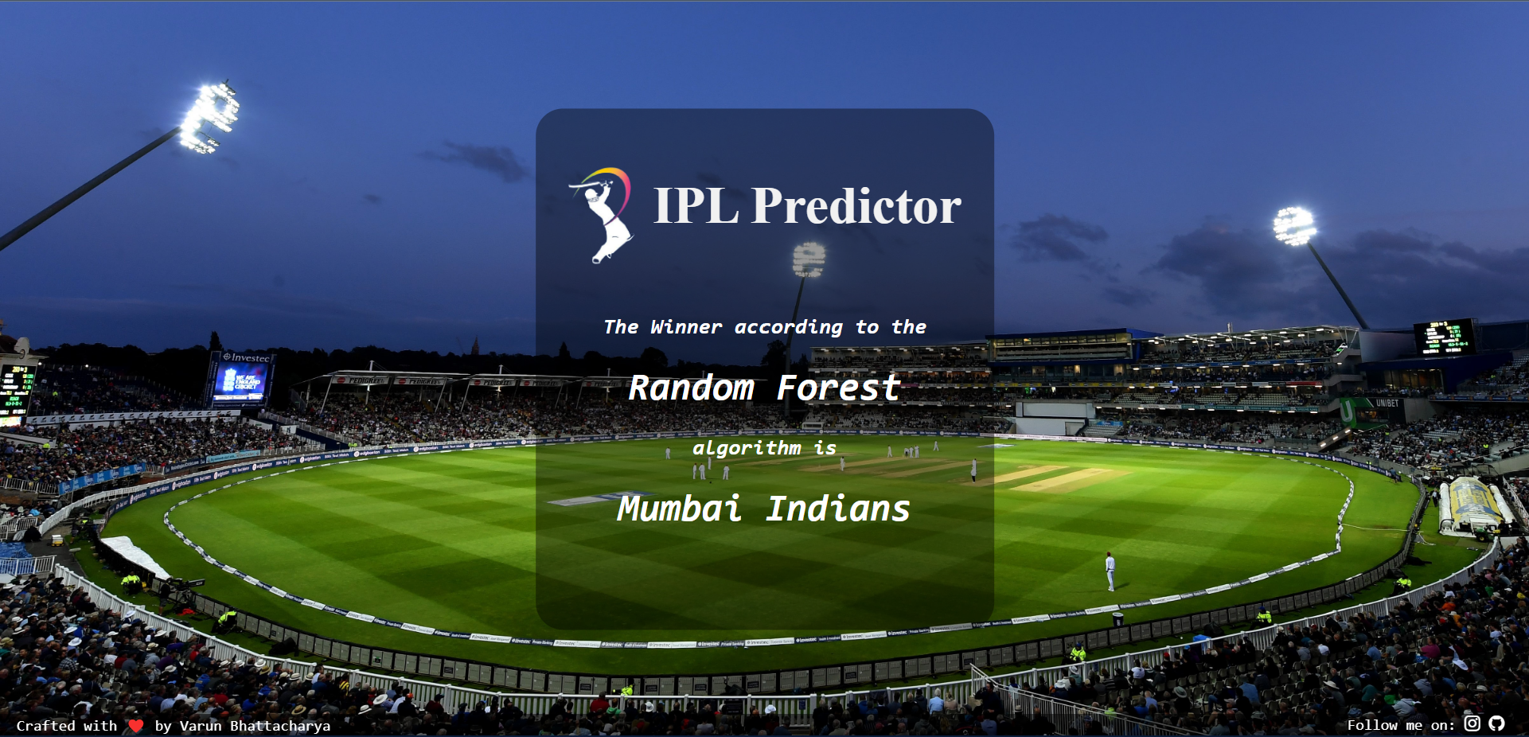
Result of Algorithm Used
Notes:
--Show and next--

Slide 26

Implementation Structure
Notes:
The designing of the database in PhpMyAdmin has been depicted below.

Slide 27
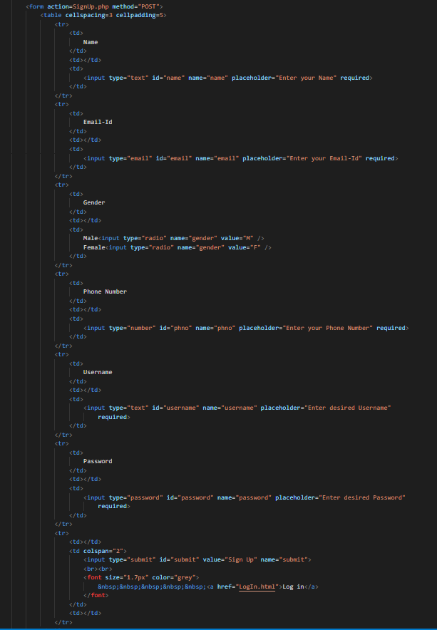
SignUp Form
Notes:
--Read through it--

Slide 28
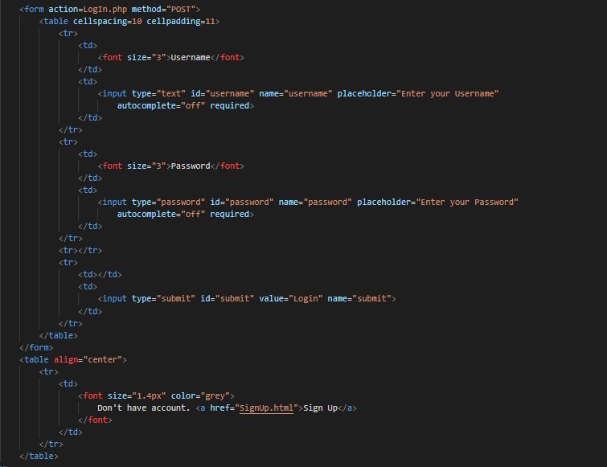
LogIn Form
Notes:
--Read through it--

Slide 29
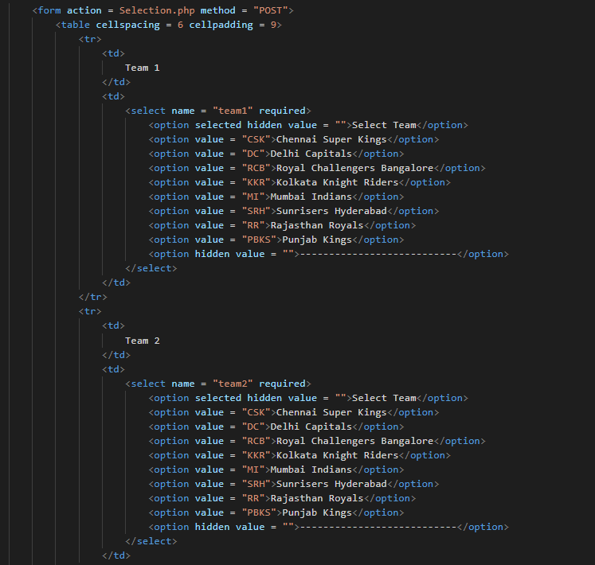
TeamSelection Form
Notes:
--Read through it--

Slide 30
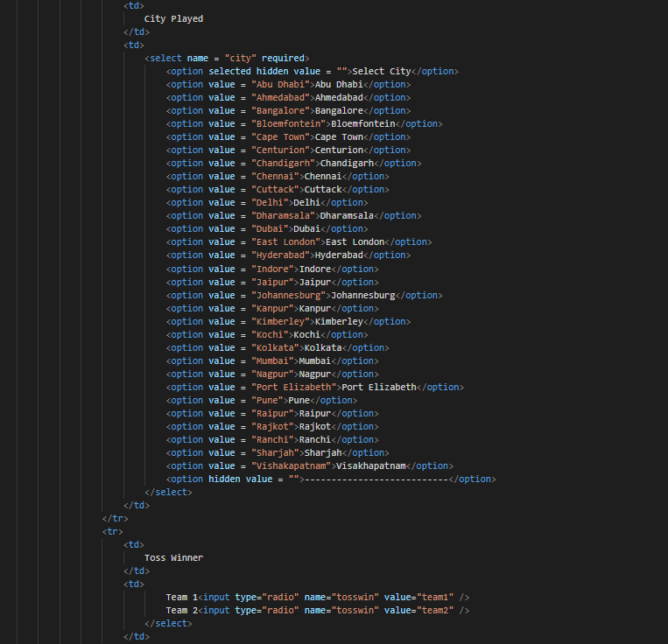
CriteriaSelection Form
Notes:
--Read through it--

Slide 31
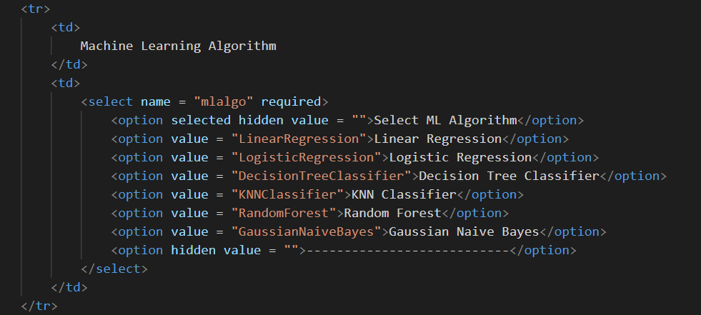
AlgorithmSelection Form
Notes:
--Read through it--

Slide 32
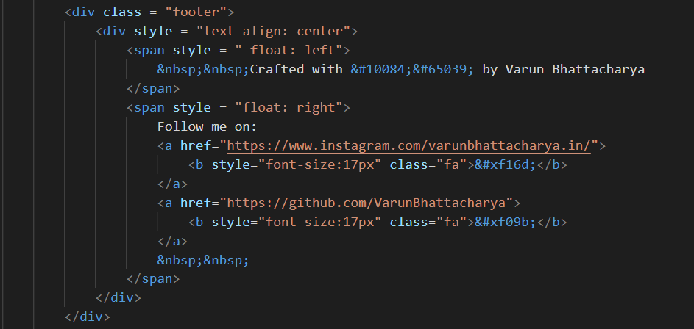
Footer Form
Notes:
--Read through it--

Slide 33

Database Design
Notes:
The designing of the database in PhpMyAdmin has been depicted below.

Slide 34
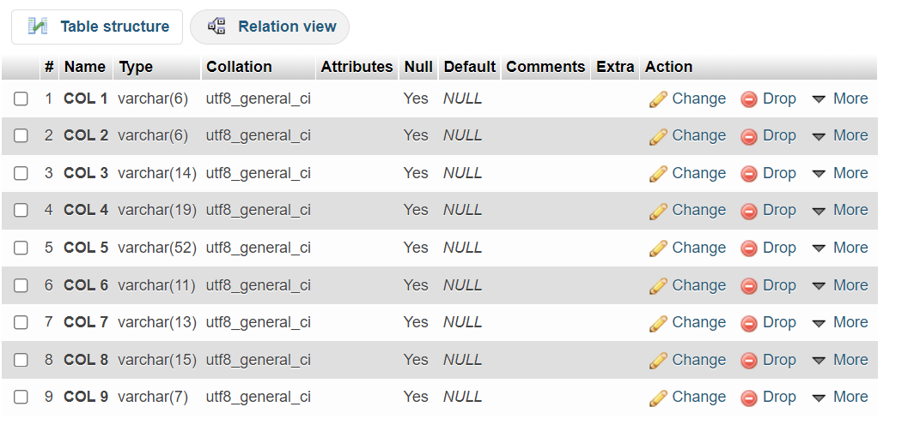
Previous Year Dataset Structure
Notes:
--Show and next--

Slide 35
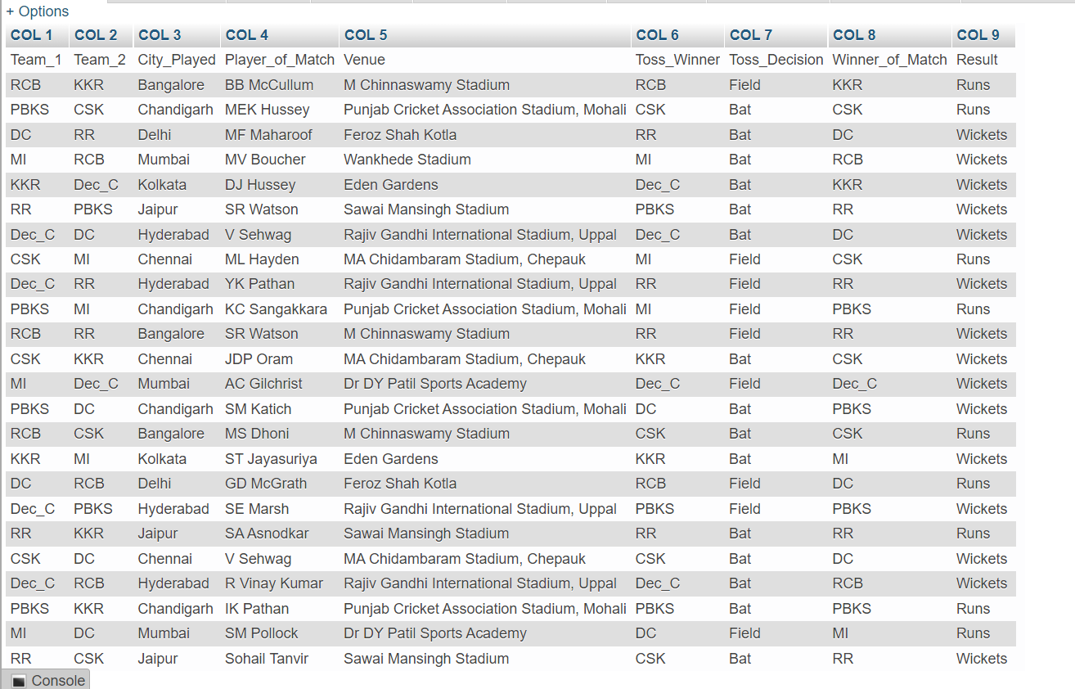
Previous Year Dataset Values(25)
Notes:
--Show and next--

Slide 36
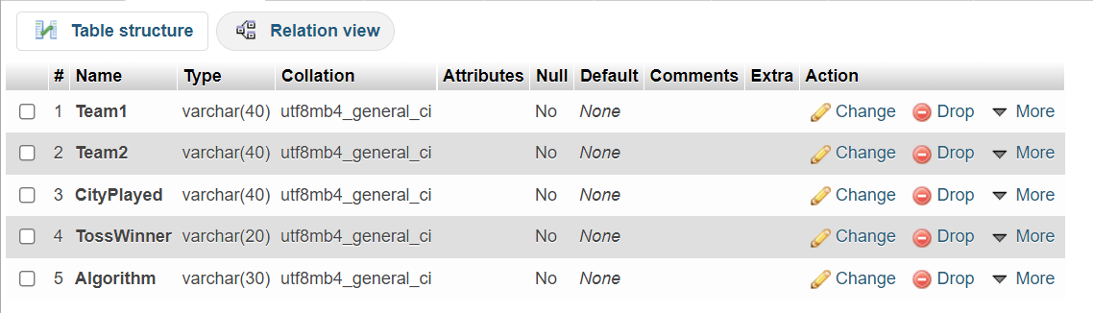
User input values table structure
Notes:
--Show and next--

Slide 37
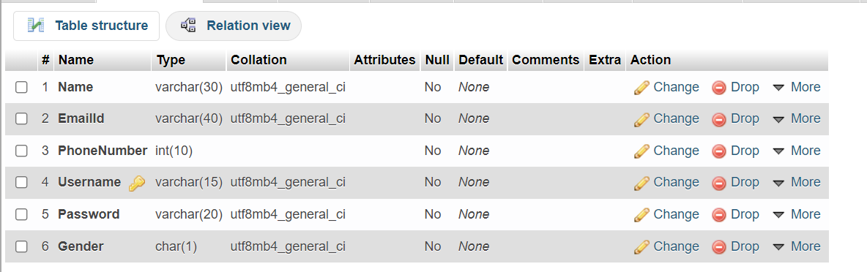
User info table structure
Notes:
--Show and next--

Slide 38

Video Demo !!!
Notes:
Here is the introductory video built for the web application.

Slide 39

Notes:
--Show and next--

Slide 40

Any Questions ???
Notes:
Any Questions???

Slide 41
Thank You !!!
Done By:
Varun Bhattacharya
Notes:
That’s all from my side. Thank you.

